Slide 1

Product Technical Training
Module 2. Development Process

Slide 2
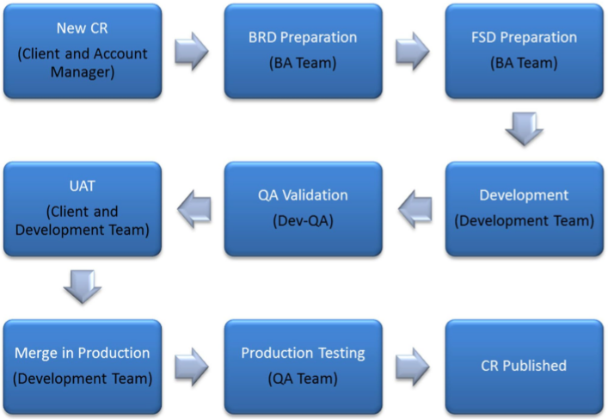
Development Process
Notes:
Business requirement(BRD):
Client informs about his requirement
It is analyzed and important details are captured in the Business Requirement(BRD)document
Specification :
Details requirement are defined and updated in the specification document on how it will work in TS and related applications.
Development :
CR is coded by development team.
Unit testing done by developers
User Assistant Testing (UAT) testing:
Client tests the CR in development code.
QA team given the CR for internal testing
Merge in Production:
Once client gives a UAT- sign-off the CR is added in production version
Production Testing
QA does final testing in production version

Slide 3
Guideline for Development
Read the specification/requirement document
PM explains the functional details
PL/TL explains the technical details
Developer obtains all the details related to the development
Developer creates initial Technical Document.
Developer creates initial Test Case Document
Developer starts coding
Ensure all points are covered
Go through the checklist point
Do performance testing with a big DB
Developer does Unit Testing using Test case
PL/TL does testing + code review, checklist
Developer completes documentation (Tech + User doc + Test case results)
Make sure to update all the documents for the issue fix/change.
Once UAT is complete, do replications, update all relevant production documents
Notes:
Make notes of your queries. Read 4-5 times to ensure you understand clearly
PM explains the functional details of the CR to the developer.
PL/TL explains the technical details on how it is to be implemented.
Obtain details from PL/TL, documentations, trying out in TS, more clarification ask QA or Implementation team.
Developer creates initial Technical Document with one liner’s. Validate it PL/TL to check if you are on the right path
Developer creates initial Test Case Document and list down all possible scenarios to handle before coding
Follow coding guideline, code clean and well formatted, comment your code.
Once development is complete, read specs again to ensure all points are covered.
To ensure all basic areas and best practices are handled.
After development, Make sure to update all the documents for the issue fix/change.

Slide 4
Issues
QA Issues
Issues encountered during internal testing
Logged by QA Team on JIRA Site
UAT Issues
Issues encountered during UAT by client
Logged by Client in the UAT section on Support Log
Support Issues
Issues encountered by clients during usage of the product
Logged by Client in TS Log section of the Support Log
Fixed by Development Team
Fixed by Development Team
Fixed by Support Team; Some issues may be fixed by the Development Team

Slide 5
Issues
An Issue could represent a software bug, a project task, a help desk ticket…
Support Log
QA Defect
CR Defect
Regression Defect
Notes:
If the client encounters any issues it gets logged to the Support Log, the support first line handles these issues.
QA Issues are logged on to the JIRA site
QA defect => at QA Validation
CR defect => at Merge in Production
Regression defect => at Production Test when the product is distributed

